Slide 1
Long-term results of Endoscopic Sleeve Gastroplasty
Maria Valeria Matteo, Vincenzo Bove, Gabriele Ciasca, Giorgio Carlino, Valerio Pontecorvi, Martina De Siena, Riccardo Di Santo, Loredana Gualtieri, Giulia Giannetti, Michaela Angeletti, Nausicaa Antonini, Chiara Massari, Chiara Chiarini, Massimiliano Papi, Cristiano Spada, Ivo Boskoski
Fondazione Policlinico Universitario A. Gemelli IRCCS, Roma
Università Cattolica del Sacro Cuore, Roma

Slide 2
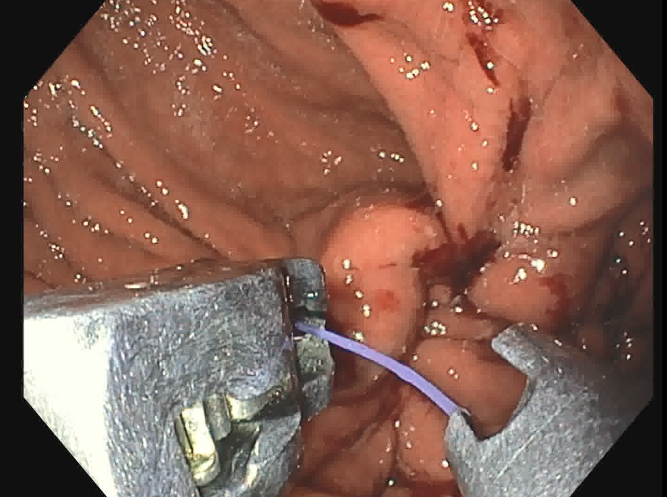
Background and Aims
Endoscopic sleeve gastroplasty (ESG) has emerged as a minimally invasive technique to fill the therapeutic gap between medical and surgical approaches to obesity.
Most of the published data on ESG show the procedure’s outcomes in the first 12-24 months.
In this study, we aim to report long-term results of ESG to implement the evidence of long-term effectiveness further.

Slide 3
Methods
A retrospective analysis was performed on a prospective database including patients with obesity (BMI ≥ 30 kg/m²) who underwent ESG (May 2017- March 2021)
Weight loss (%EWL, %TBWL) and quality of life (Bariatric Analysis and Reporting Outcome System, BAROS questionnaire) were evaluated up to 3 years (36 months).

Slide 4
Results
240 subjects (72% F) underwent ESG with a median BMI of 37.2 (35.3-40.8) kg/m² at baseline and a median age of 44.5 (36-54) years.
No severe procedure-related adverse events occurred.
Baseline characterists of patients
Age | 44.5 (36-54)*
Gender (F) | 72%
BMI | 37.2 (35.3 – 40.8)*
Diabetes | 5%
Hyperinsulinemia | 27%
Hypertension | 29%
OSAS | 9%
Class I obesity | 21.3%
Class II obesity | 50.8%
Class III obesity | 27.9%
* Median (Q1-Q3)

Slide 5
Results
 | %EWL | %TBWL | BAROS
1 month | 31.5 (22.4 - 40.6) | 9.9 (8.2-12-5) | 2.5 (2-3.5)
6 months | 49.7 (36.9-64.8) | 16.7 (12.7-21) | 4 (3-5)
12 months | 46.6 (27.9-63.2) | 15.6 (10.3-21.3) | 3,5(3-5)
24 months | 39.3 (17.6-58.4) | 12.8 (6.4-19.4) | 3 (2.5-4.6)
36 months | 36.4 (21.0-66.3) | 13.3 (6.7-23.8) | 3 (2.5-4.8)
* Median (Q1-Q3)
65% of patients: %EWL > 25% at 3 years follow-up

Slide 6
Conclusion
Our experience confirms that ESG in the setting of a multidisciplinary approach is a safe and effective procedure for the treatment of obesity, associated with sustained weight loss and improved quality of life.

Slide 7
Grazie

